Slide 1
MYTEAM
Ervino Alifio Ramadhan
Markus Raja Sinabutar
Mulya Fajar Ningsih Alwi
Samuel Pandohan Terampil Gultom

Slide 2


We will give you the best service with good quality results

Slide 3
TIMELINE
MARCH 2021
MAY 2021
JULY 2021
Designing the web application
1. Promoting the web application for pre-launching
2. Looking for service providers and users
Linking the web application to the bank payment system
APRIL 2021
JUNE 2021
Developing the web application
1. Looking for investors
2. Making a database for users data in the web application

Slide 4
TIMELINE
AUGUST 2021
OCTOBER 2021
DECEMBER 2021
Launching the web application
1. Managing and protecting users data
2. Serving service users
3. Connecting service providers and users
Developing the web application
SEPTEMBER 2021
NOVEMBER 2021
1. Advertising the web application
2. Looking for service providers and users
1. Maintaining the web application
2. Troubleshooting

Slide 5
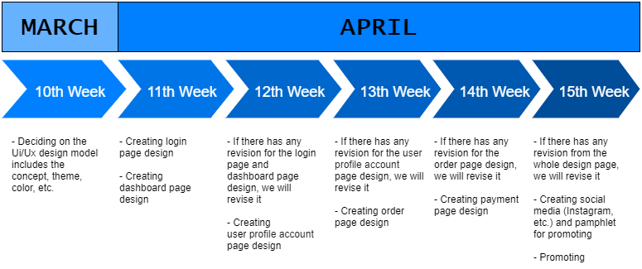
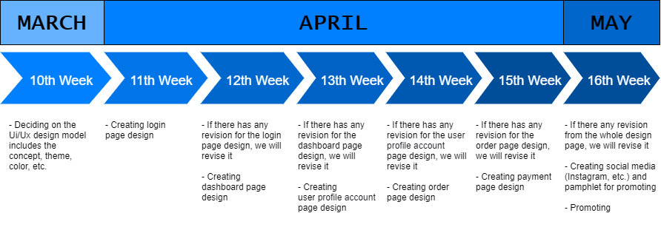

Slide 6
Progress Report

Slide 7
10th WEEK
Deciding on the UI / UX design model includes the concept, theme, color, etc.

Slide 8
DECISION
Website Concept, for our concept we will use an e-commerce website concept, where this concept is specialized as a sales tool and inside it, there will be various categories of types of services that can be ordered.
Website Display, for the display as much as possible we will make a user-friendly website for all generations, which is can be fit or used and easier to access on all devices (mobile phone, tablet, or pc).
Website Theme and Color, for the theme and color design we will use the color palette which is related to our logo (white and blue), and also there will be an additional color if it needs, to make our web more eye-catching. We will make the design to be a simple design but elegant and also can attract people to use it.

Slide 9

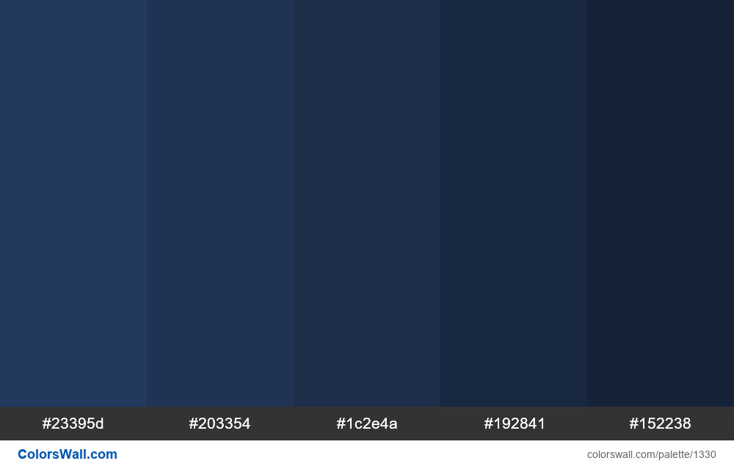

COLOR PALETTE

Slide 10
11th WEEK
Creating login page design
Creating dashboard page design

Slide 11

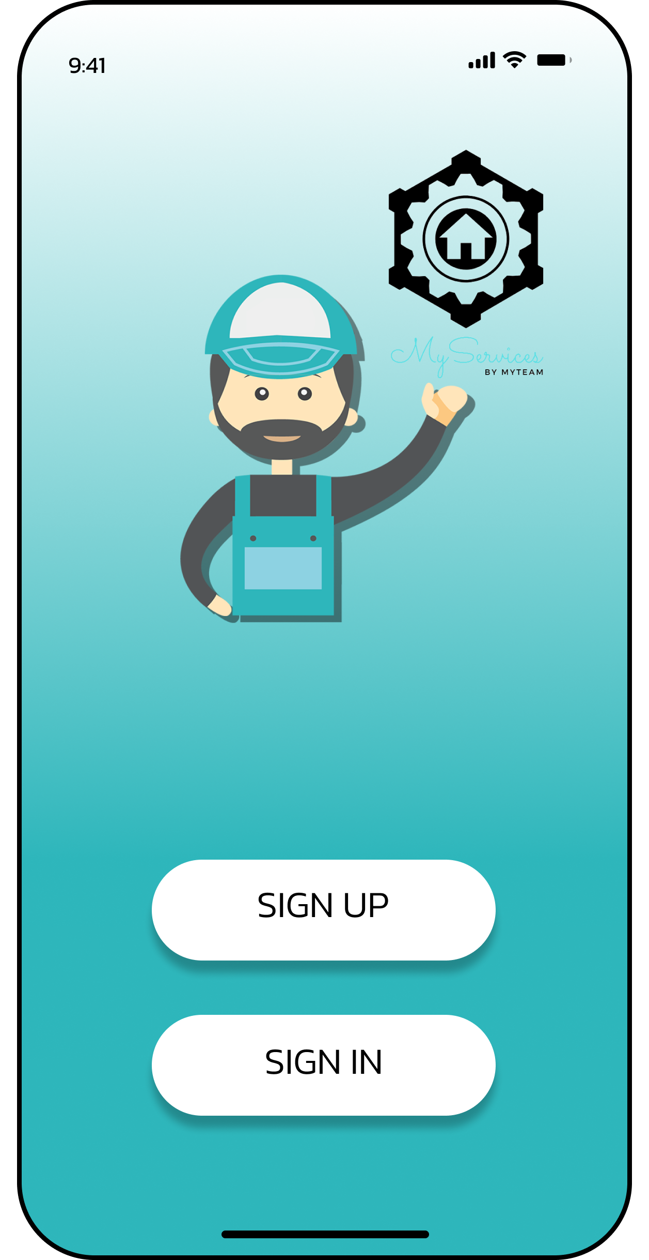
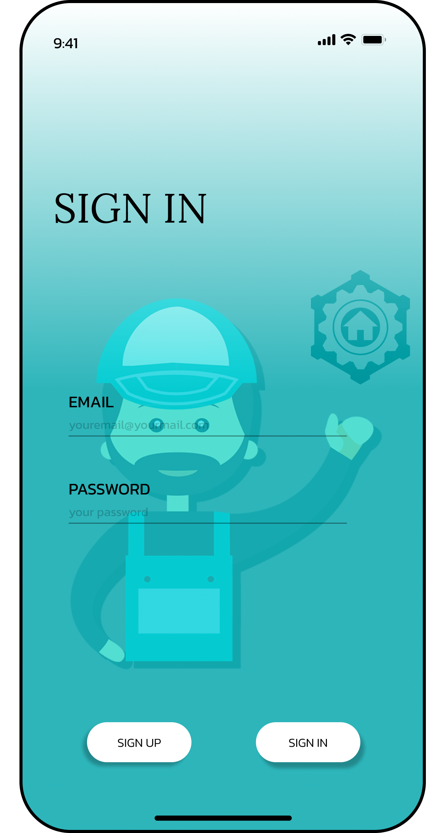
LOG-IN / SIGN-IN PAGE

Slide 12
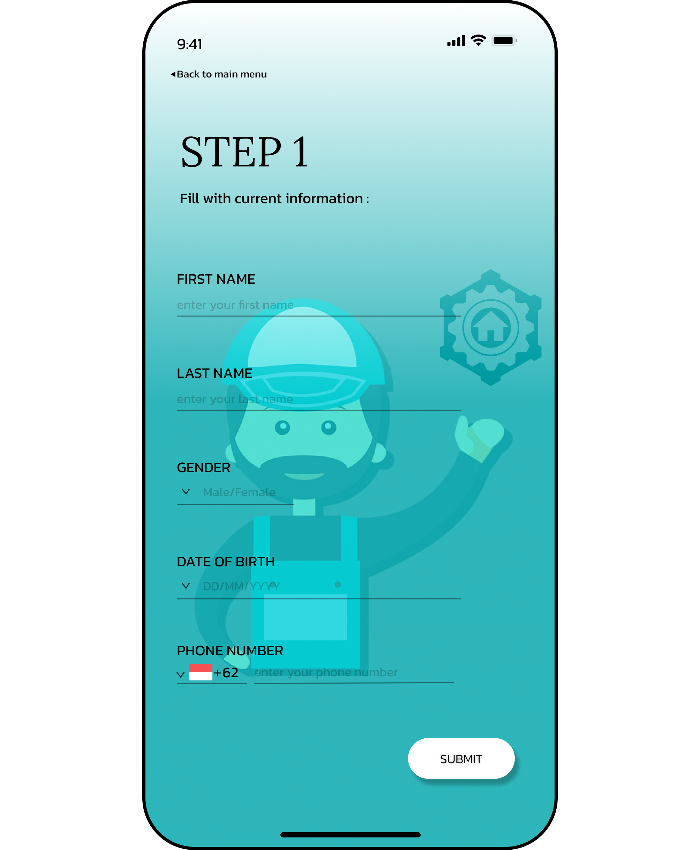
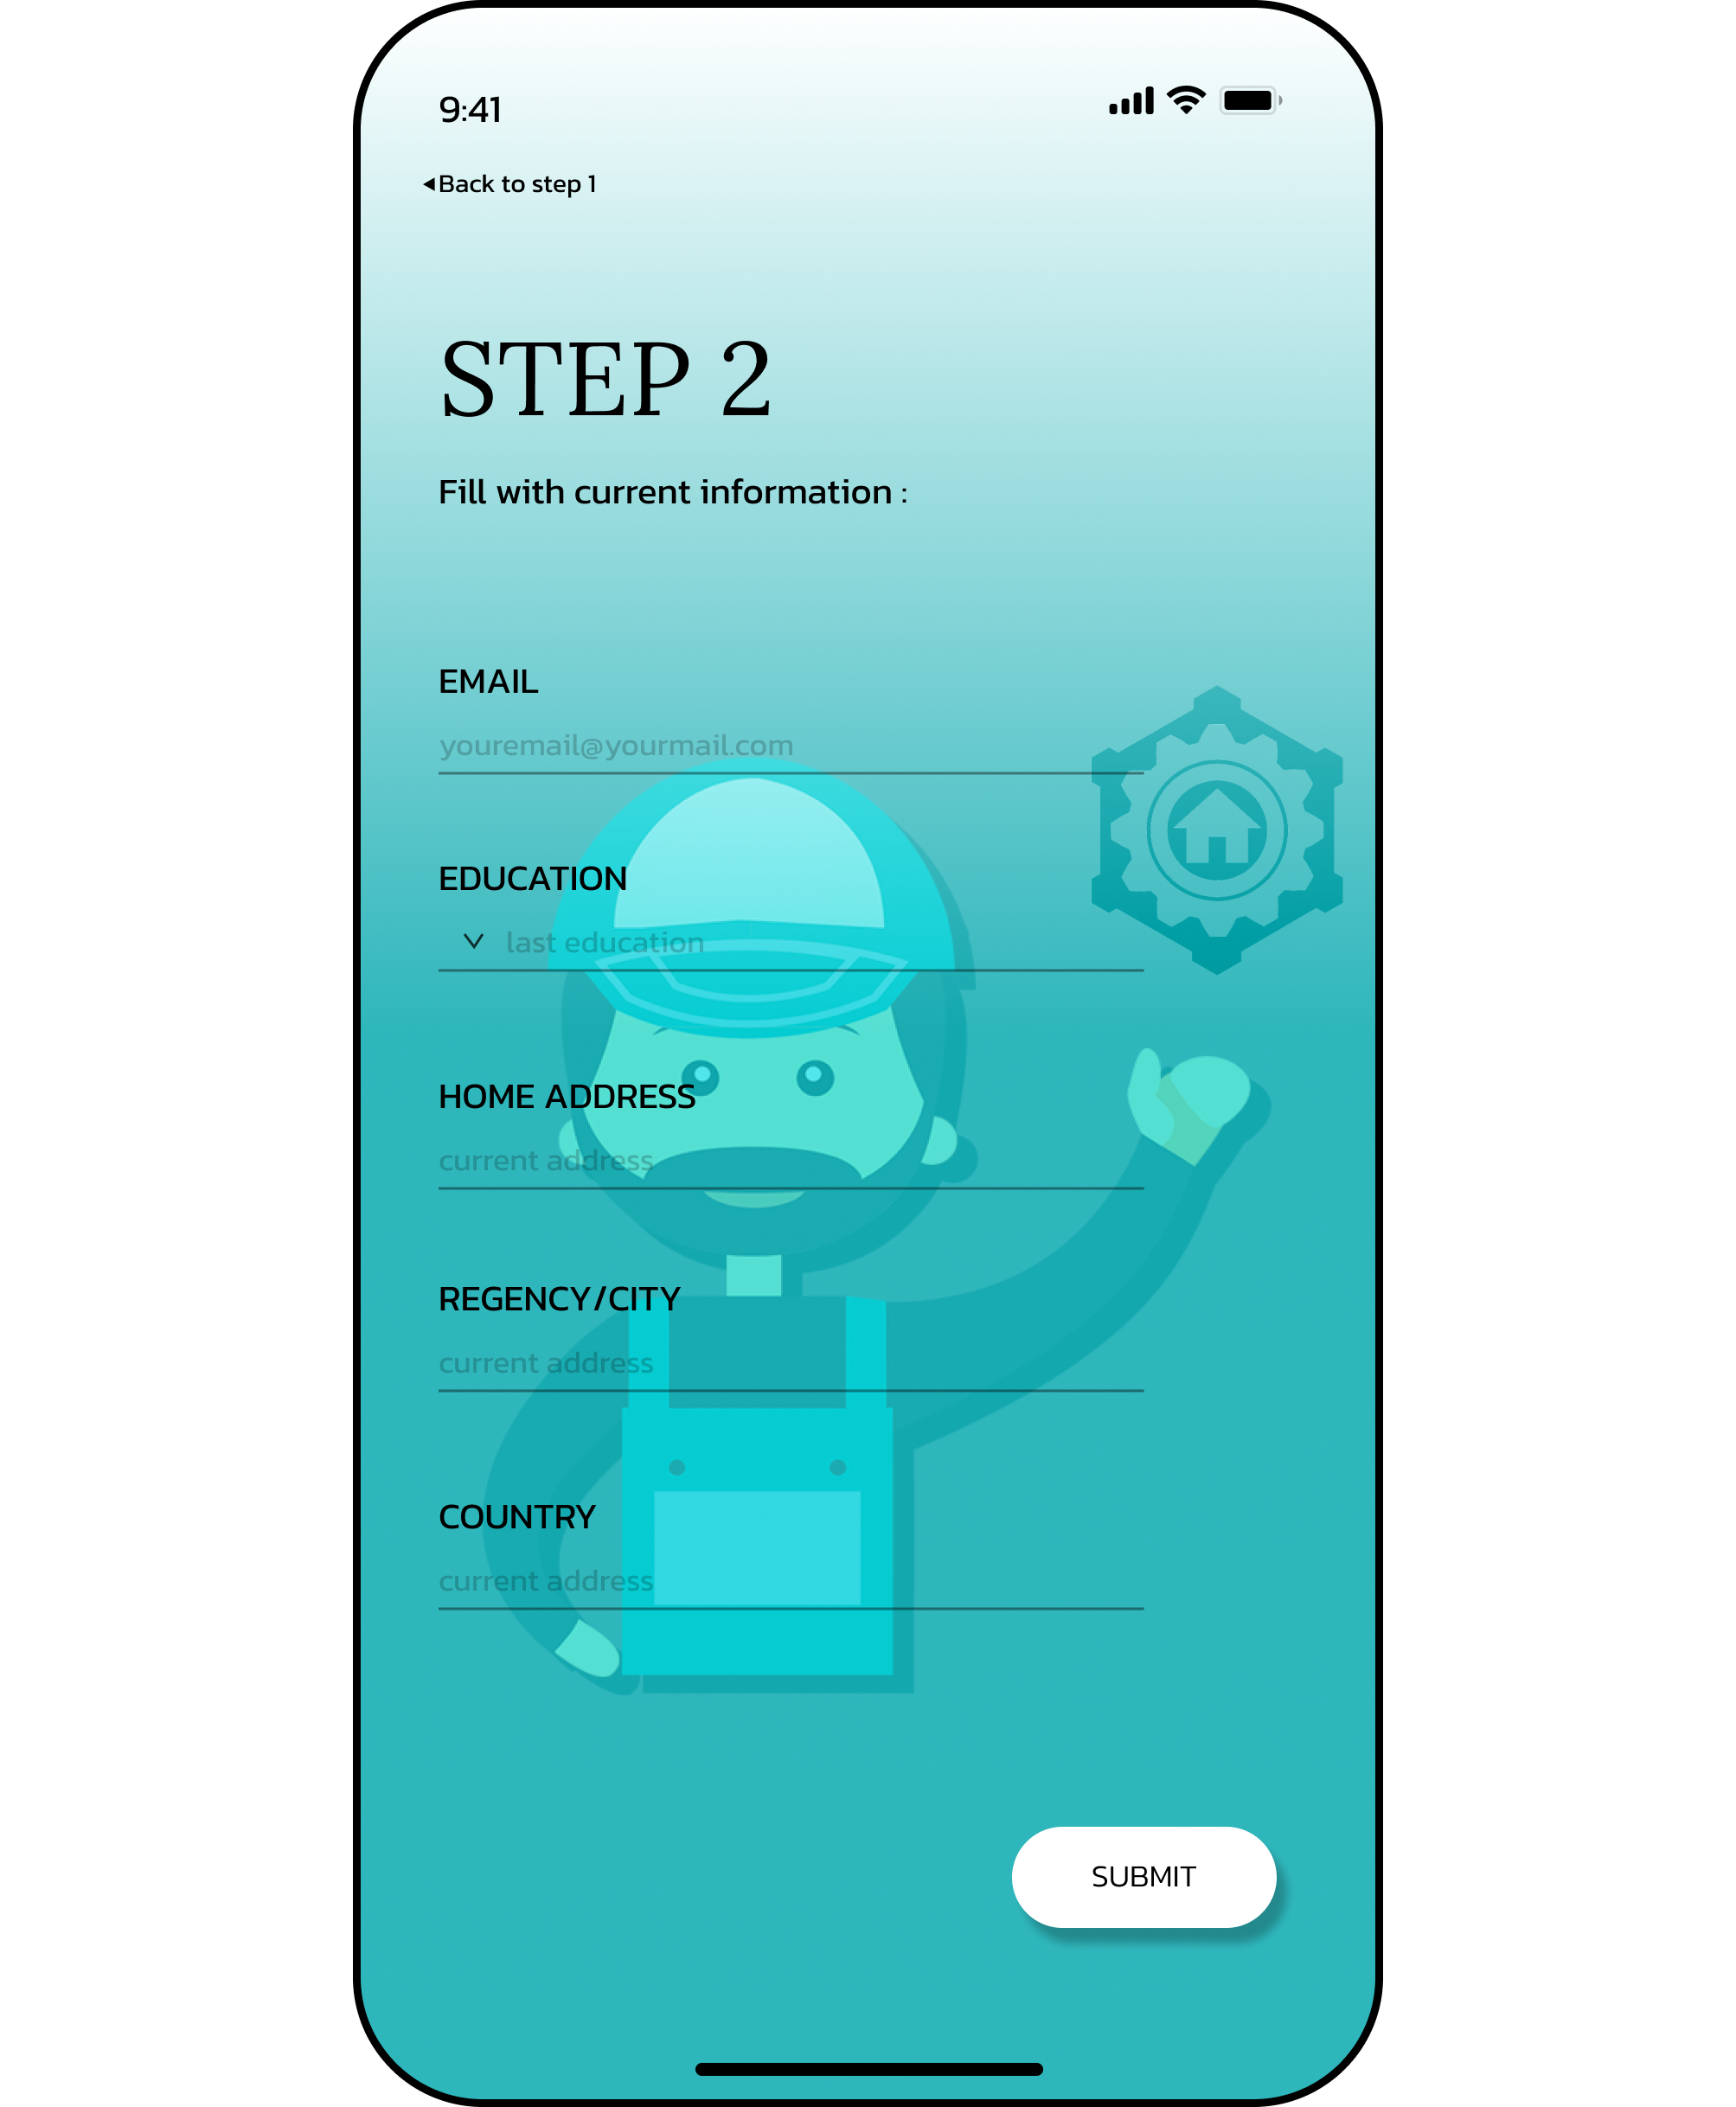
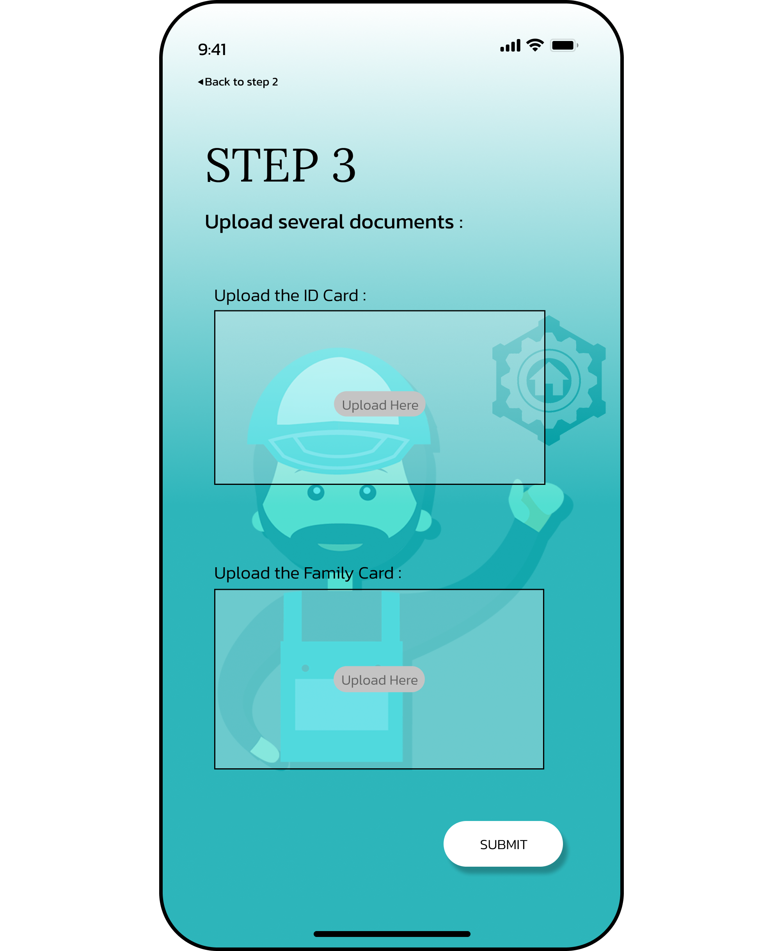
SIGN-UP PAGE

Slide 13
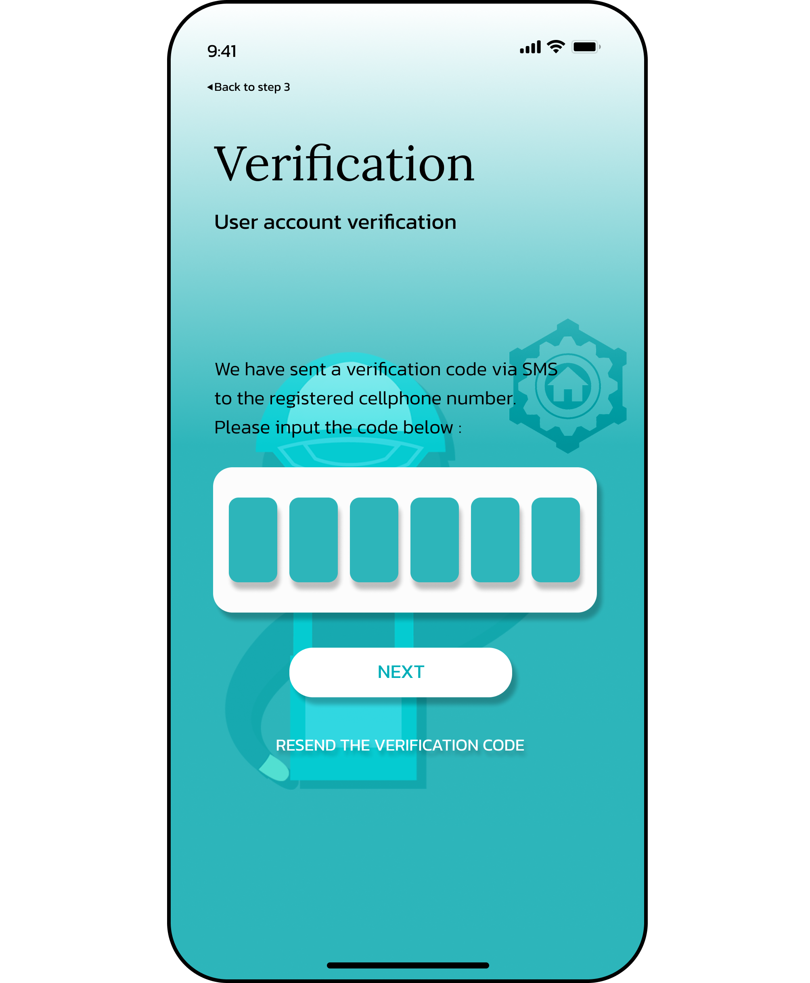
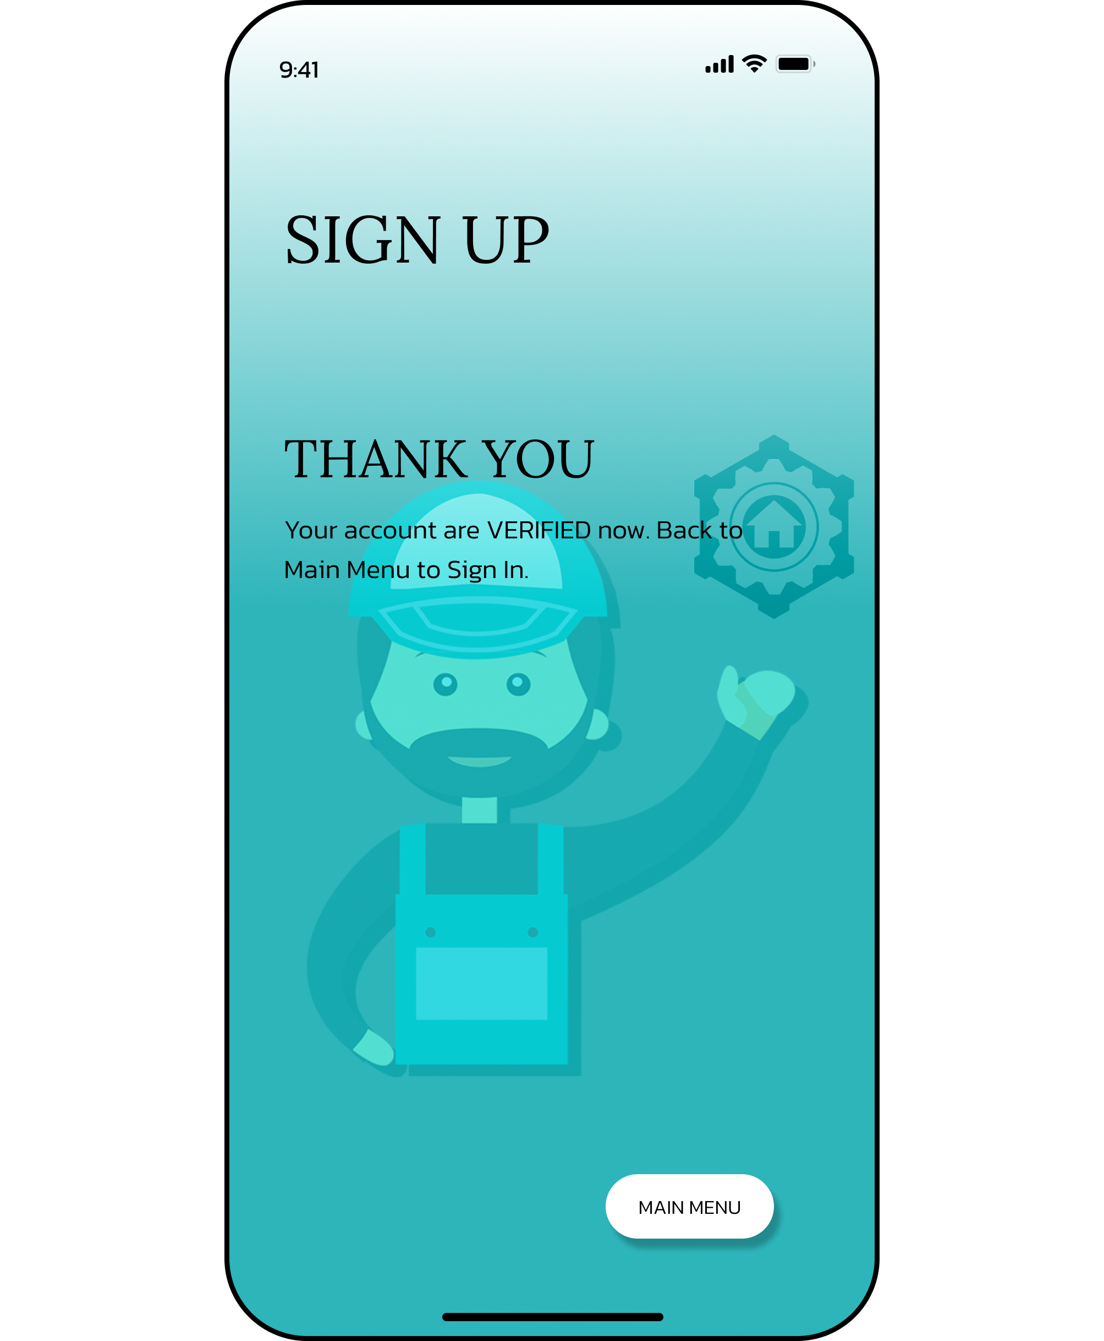
SIGN-UP PAGE

Slide 14

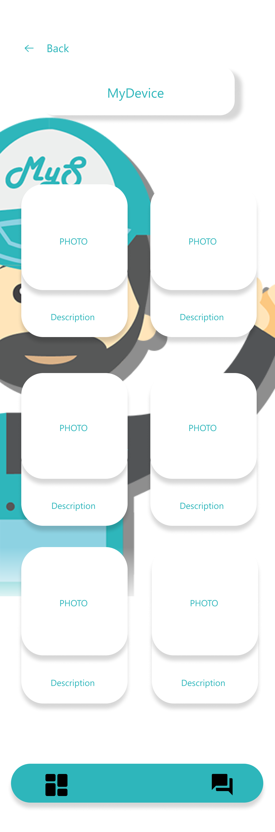
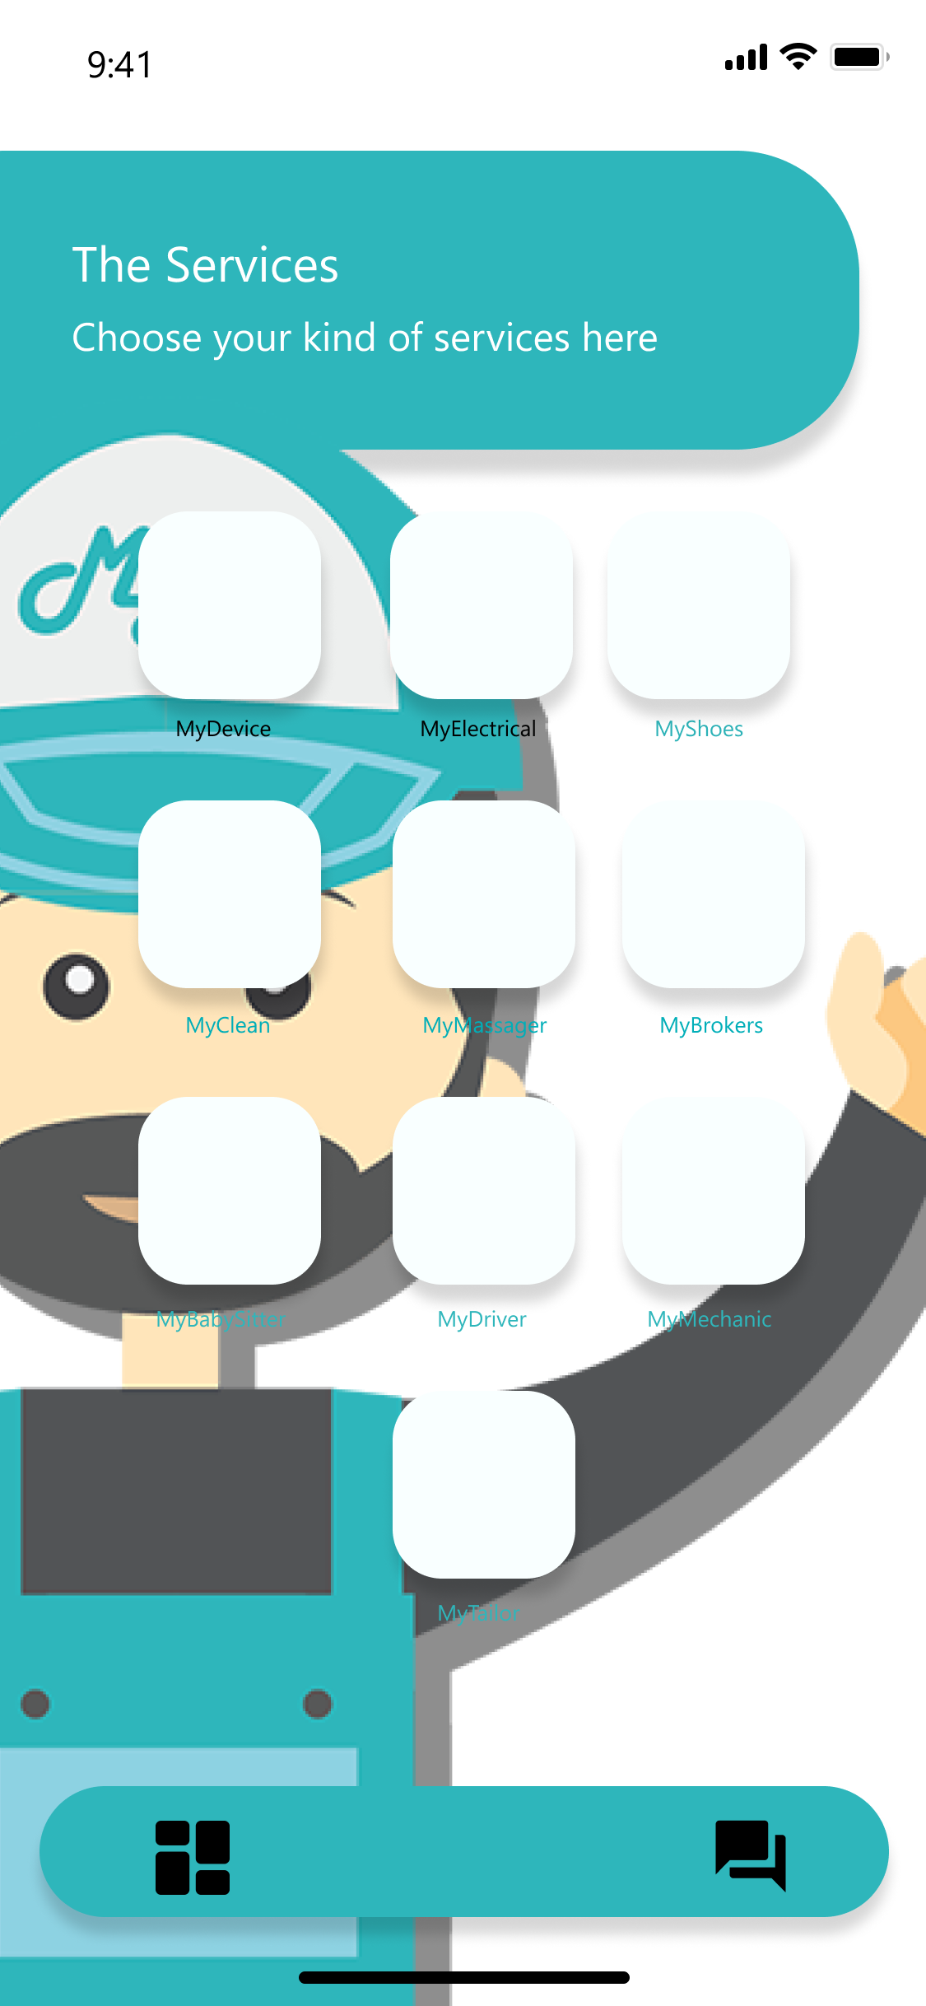
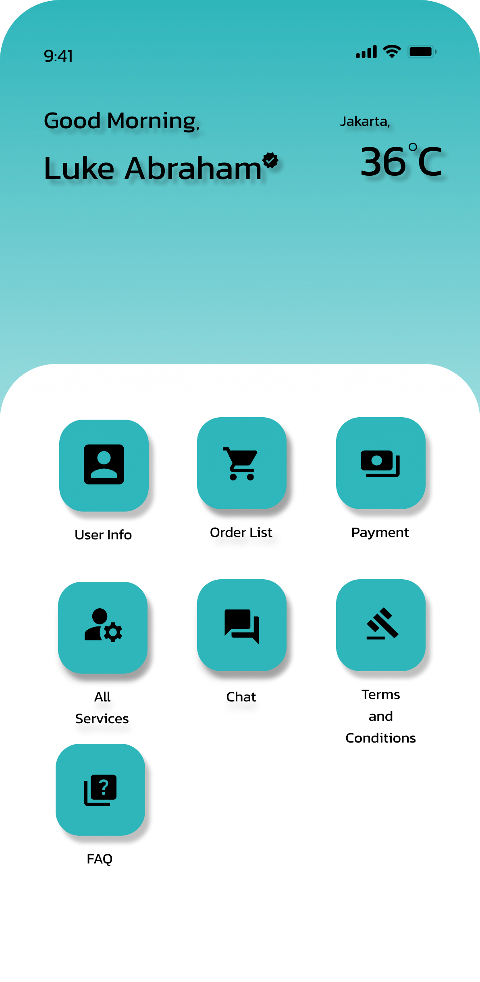
DASHBOARD PAGE

Slide 15
12th WEEK
If there has any revision for the login page and dashboard page design, we will revise it
Creating user profile account page design

Slide 16
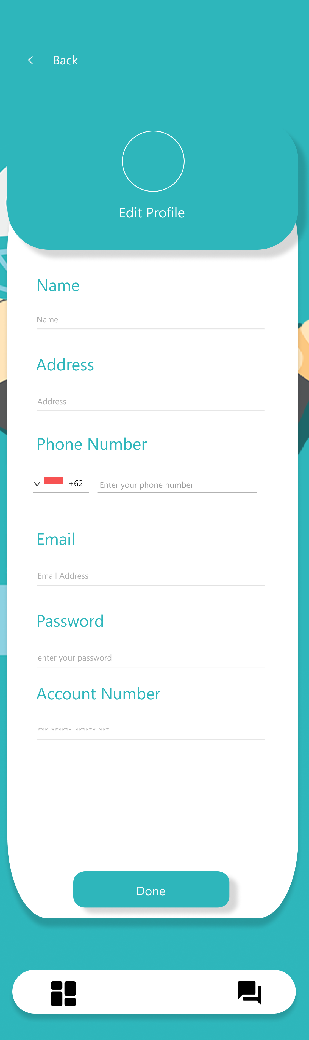
USER PROFILE ACCOUNT PAGE

Slide 17
13th WEEK
If there has any revision for the user profile account page design, we will revise it
Creating order page design

Slide 18
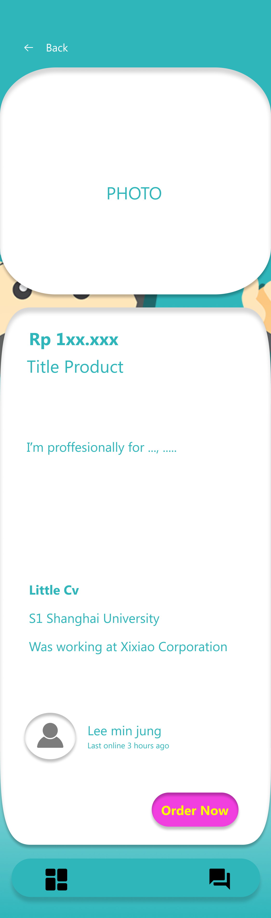
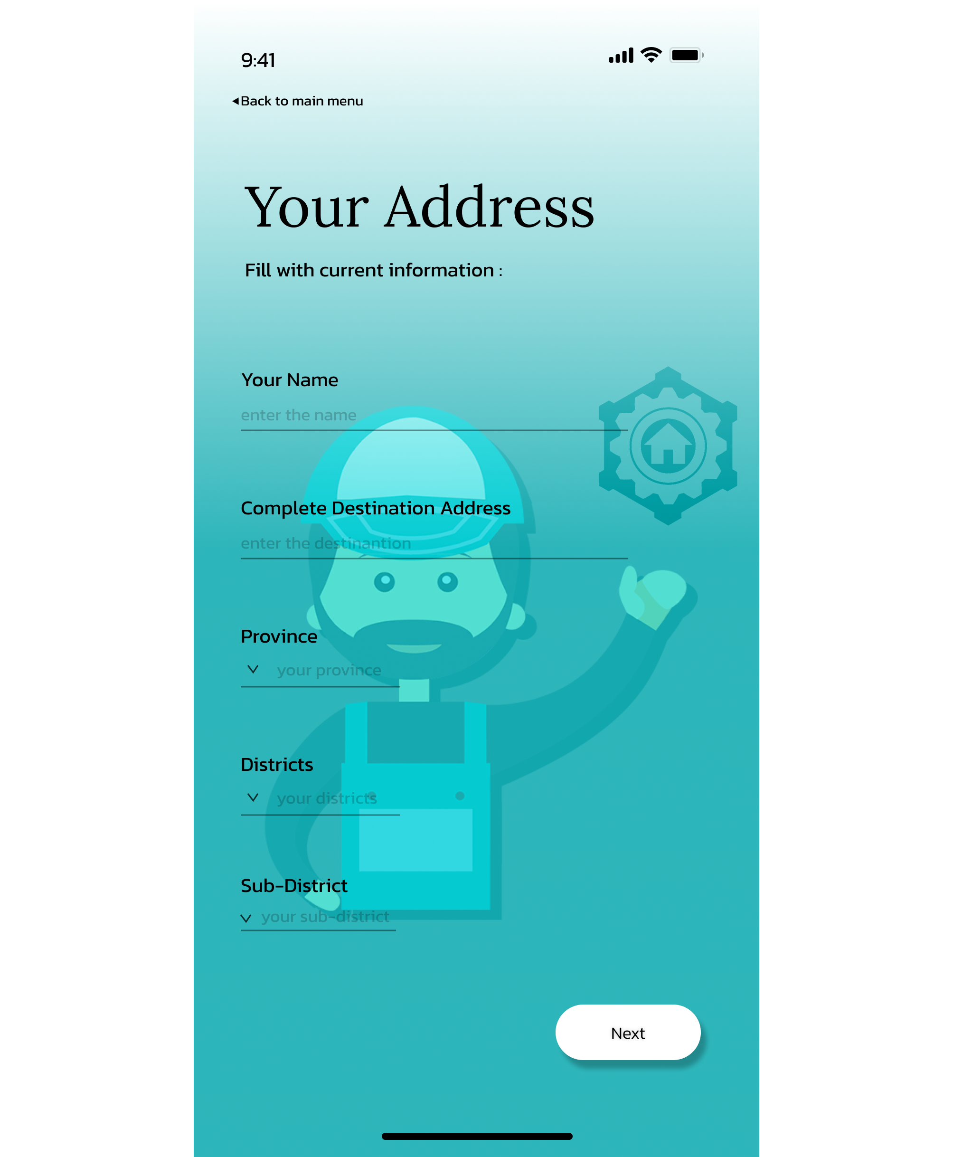
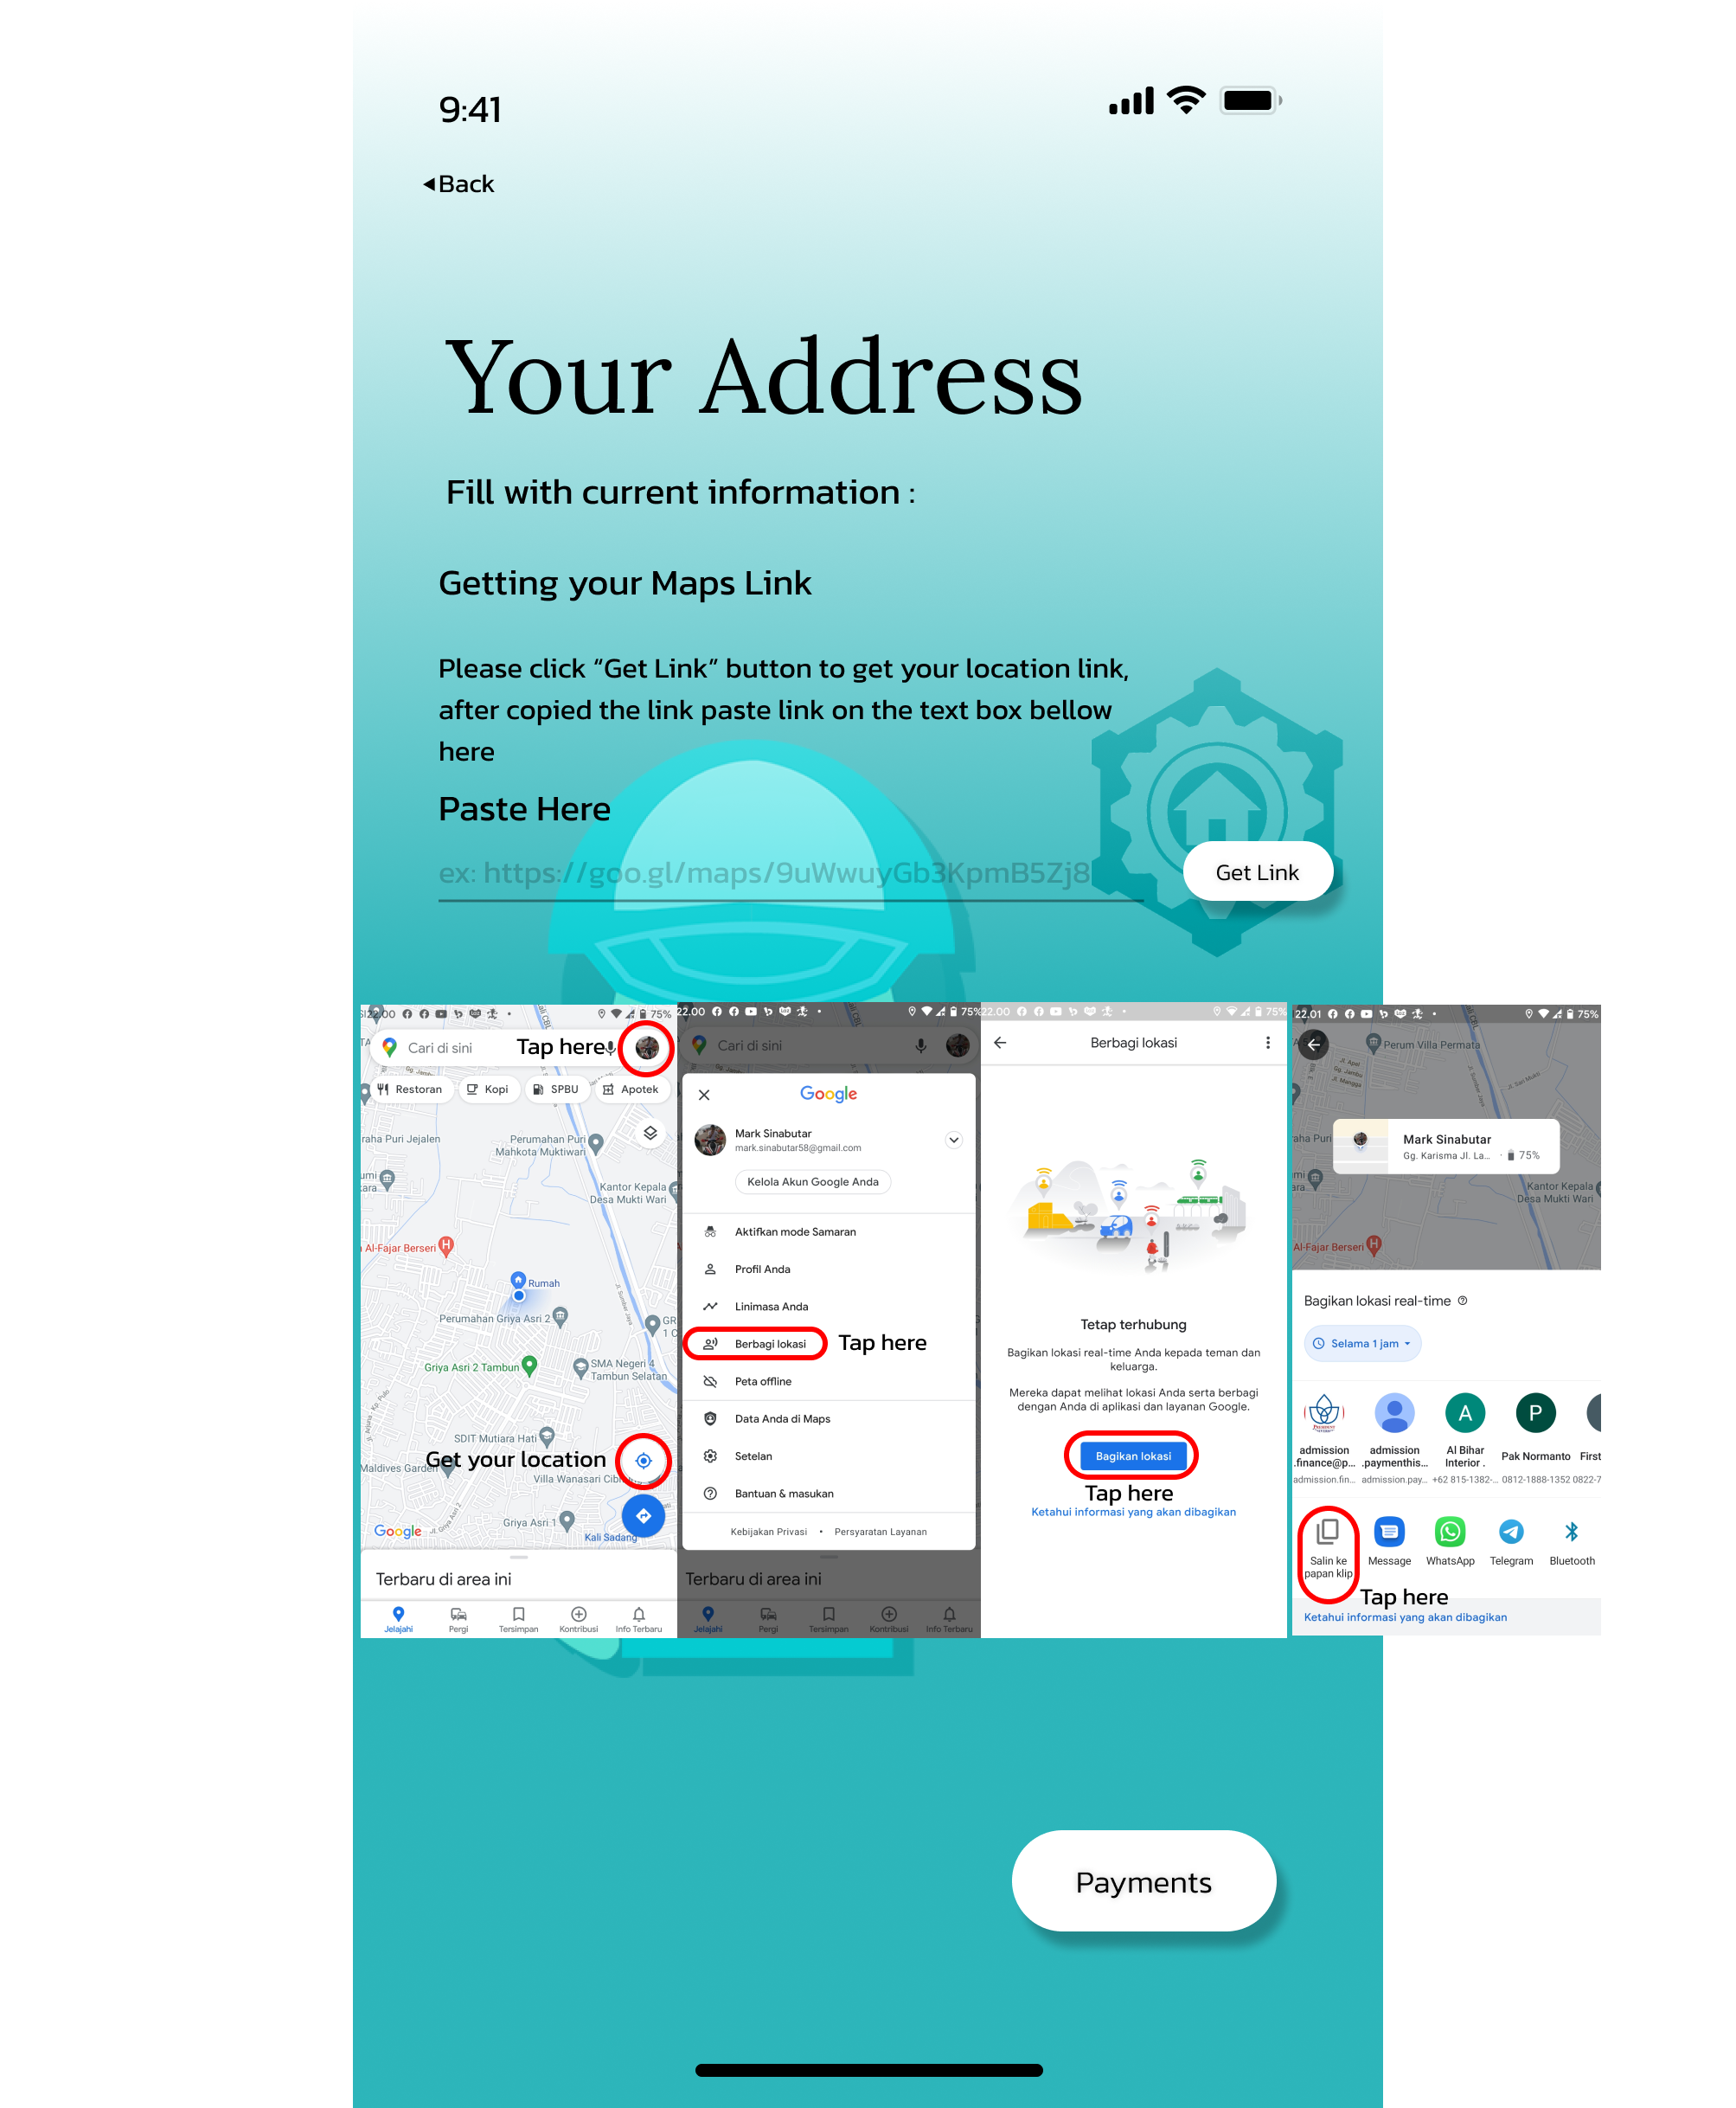
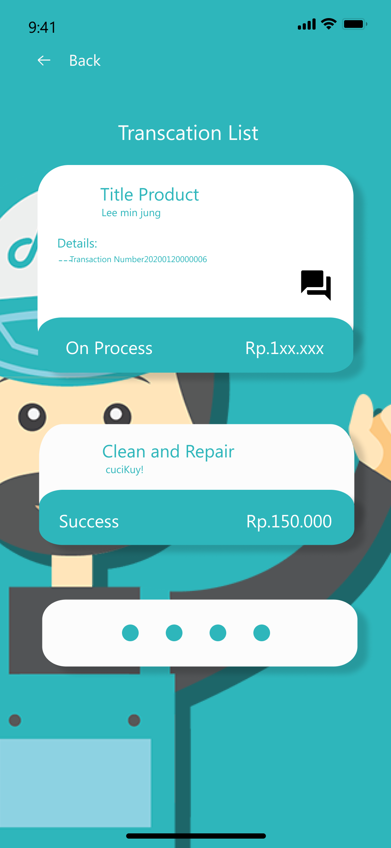
ORDER PAGE

Slide 19
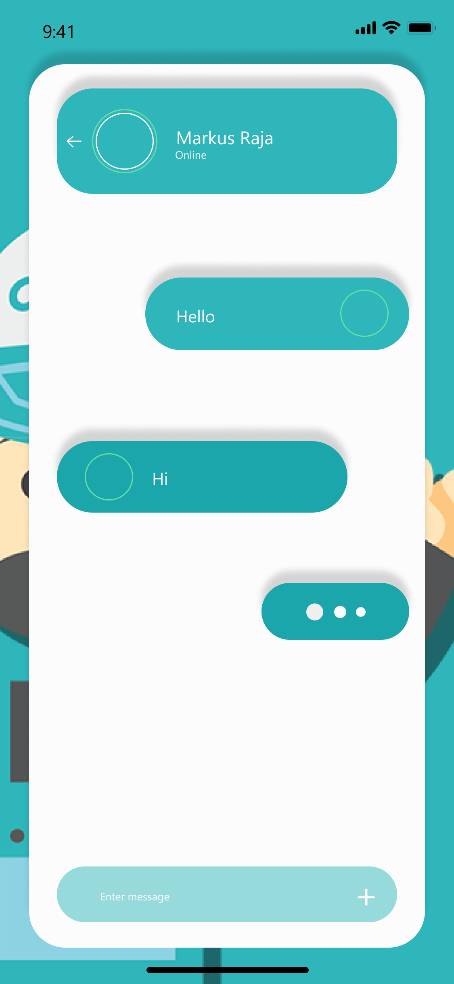
CHAT PAGE

Slide 20
14th WEEK
If there has any revision for the order page design, we will revise it
Creating payment page design

Slide 21
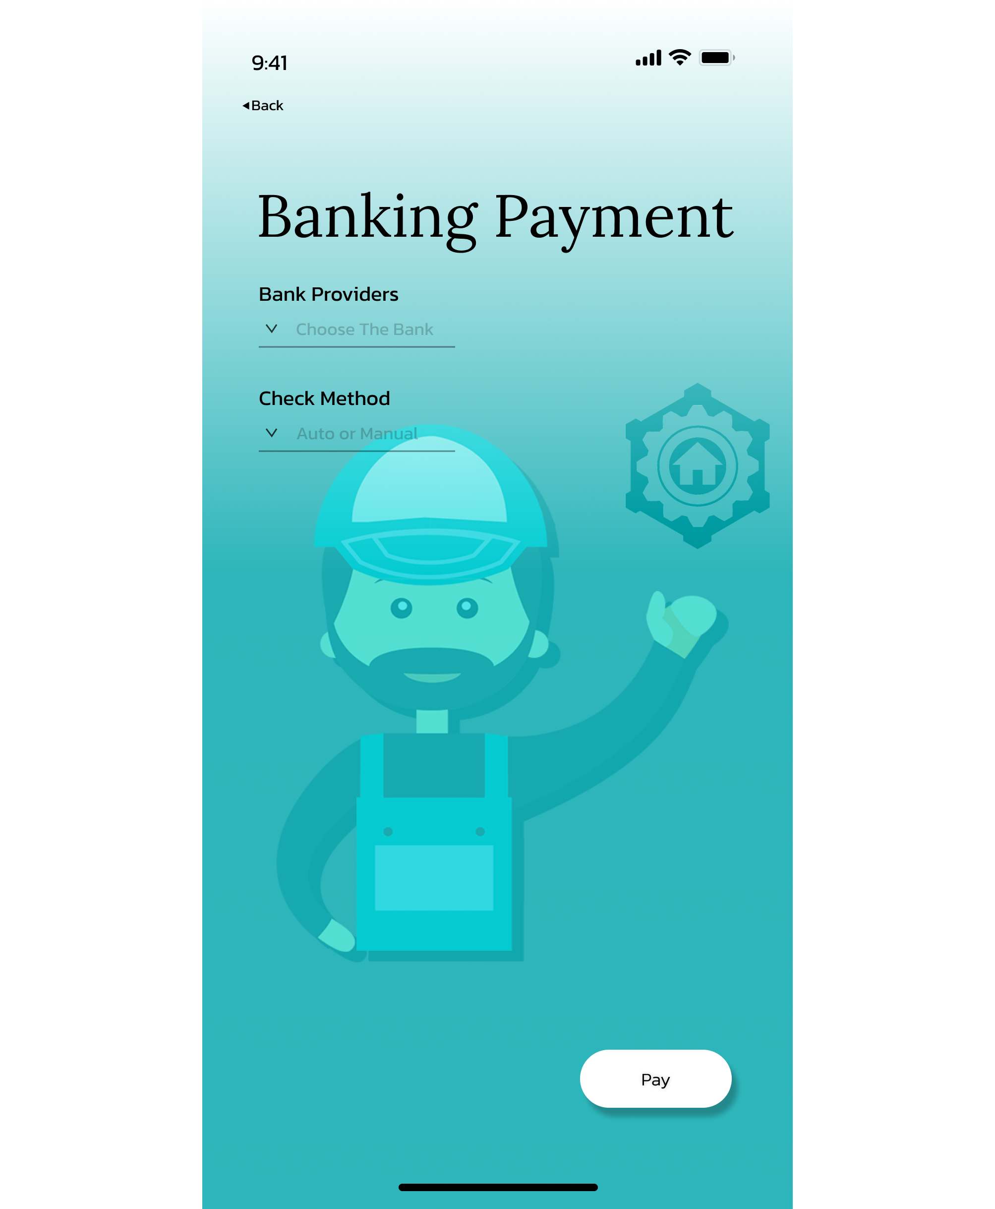
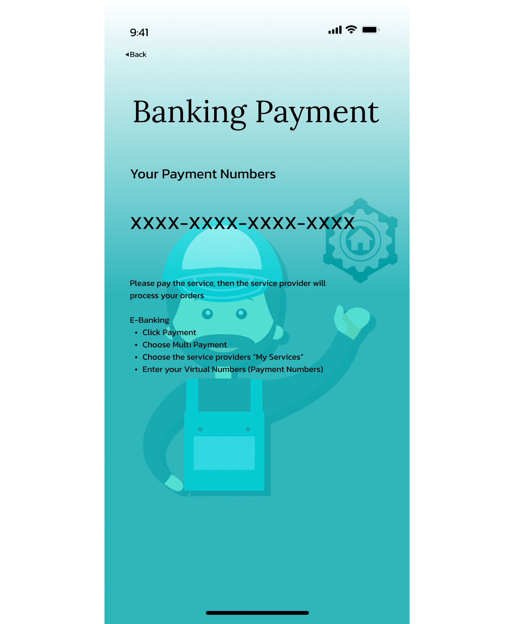
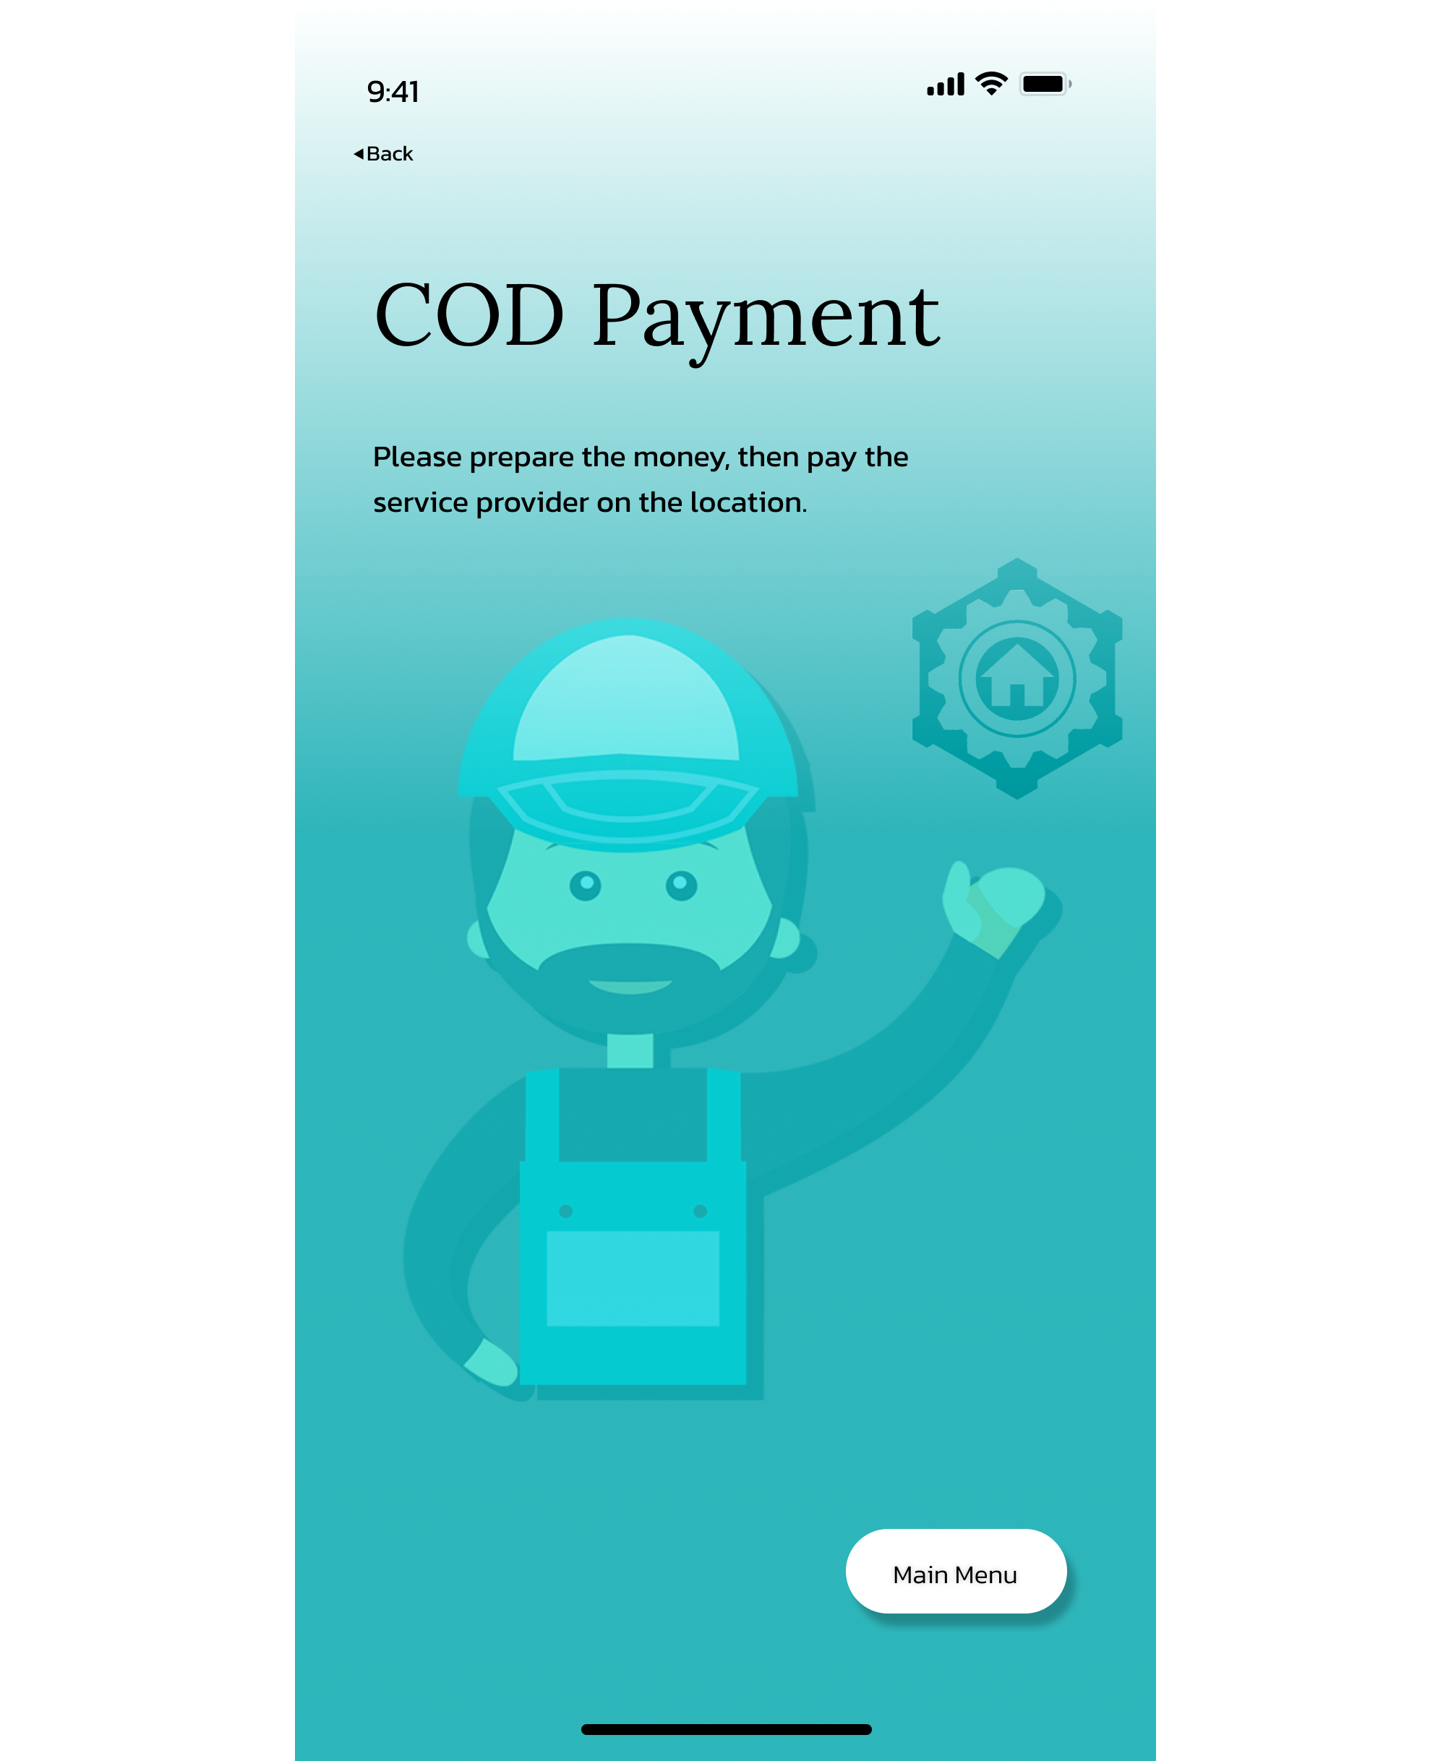
PAYMENT PAGE

Slide 22
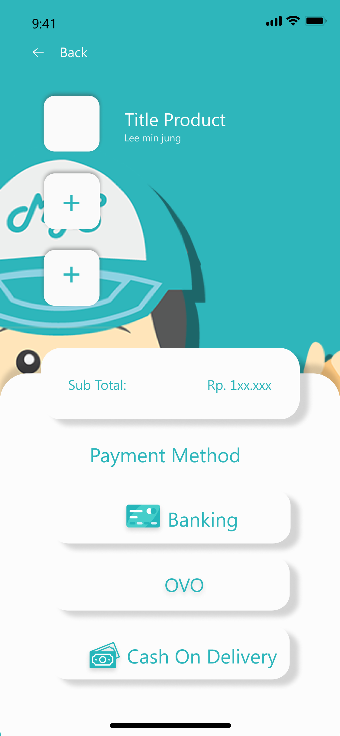
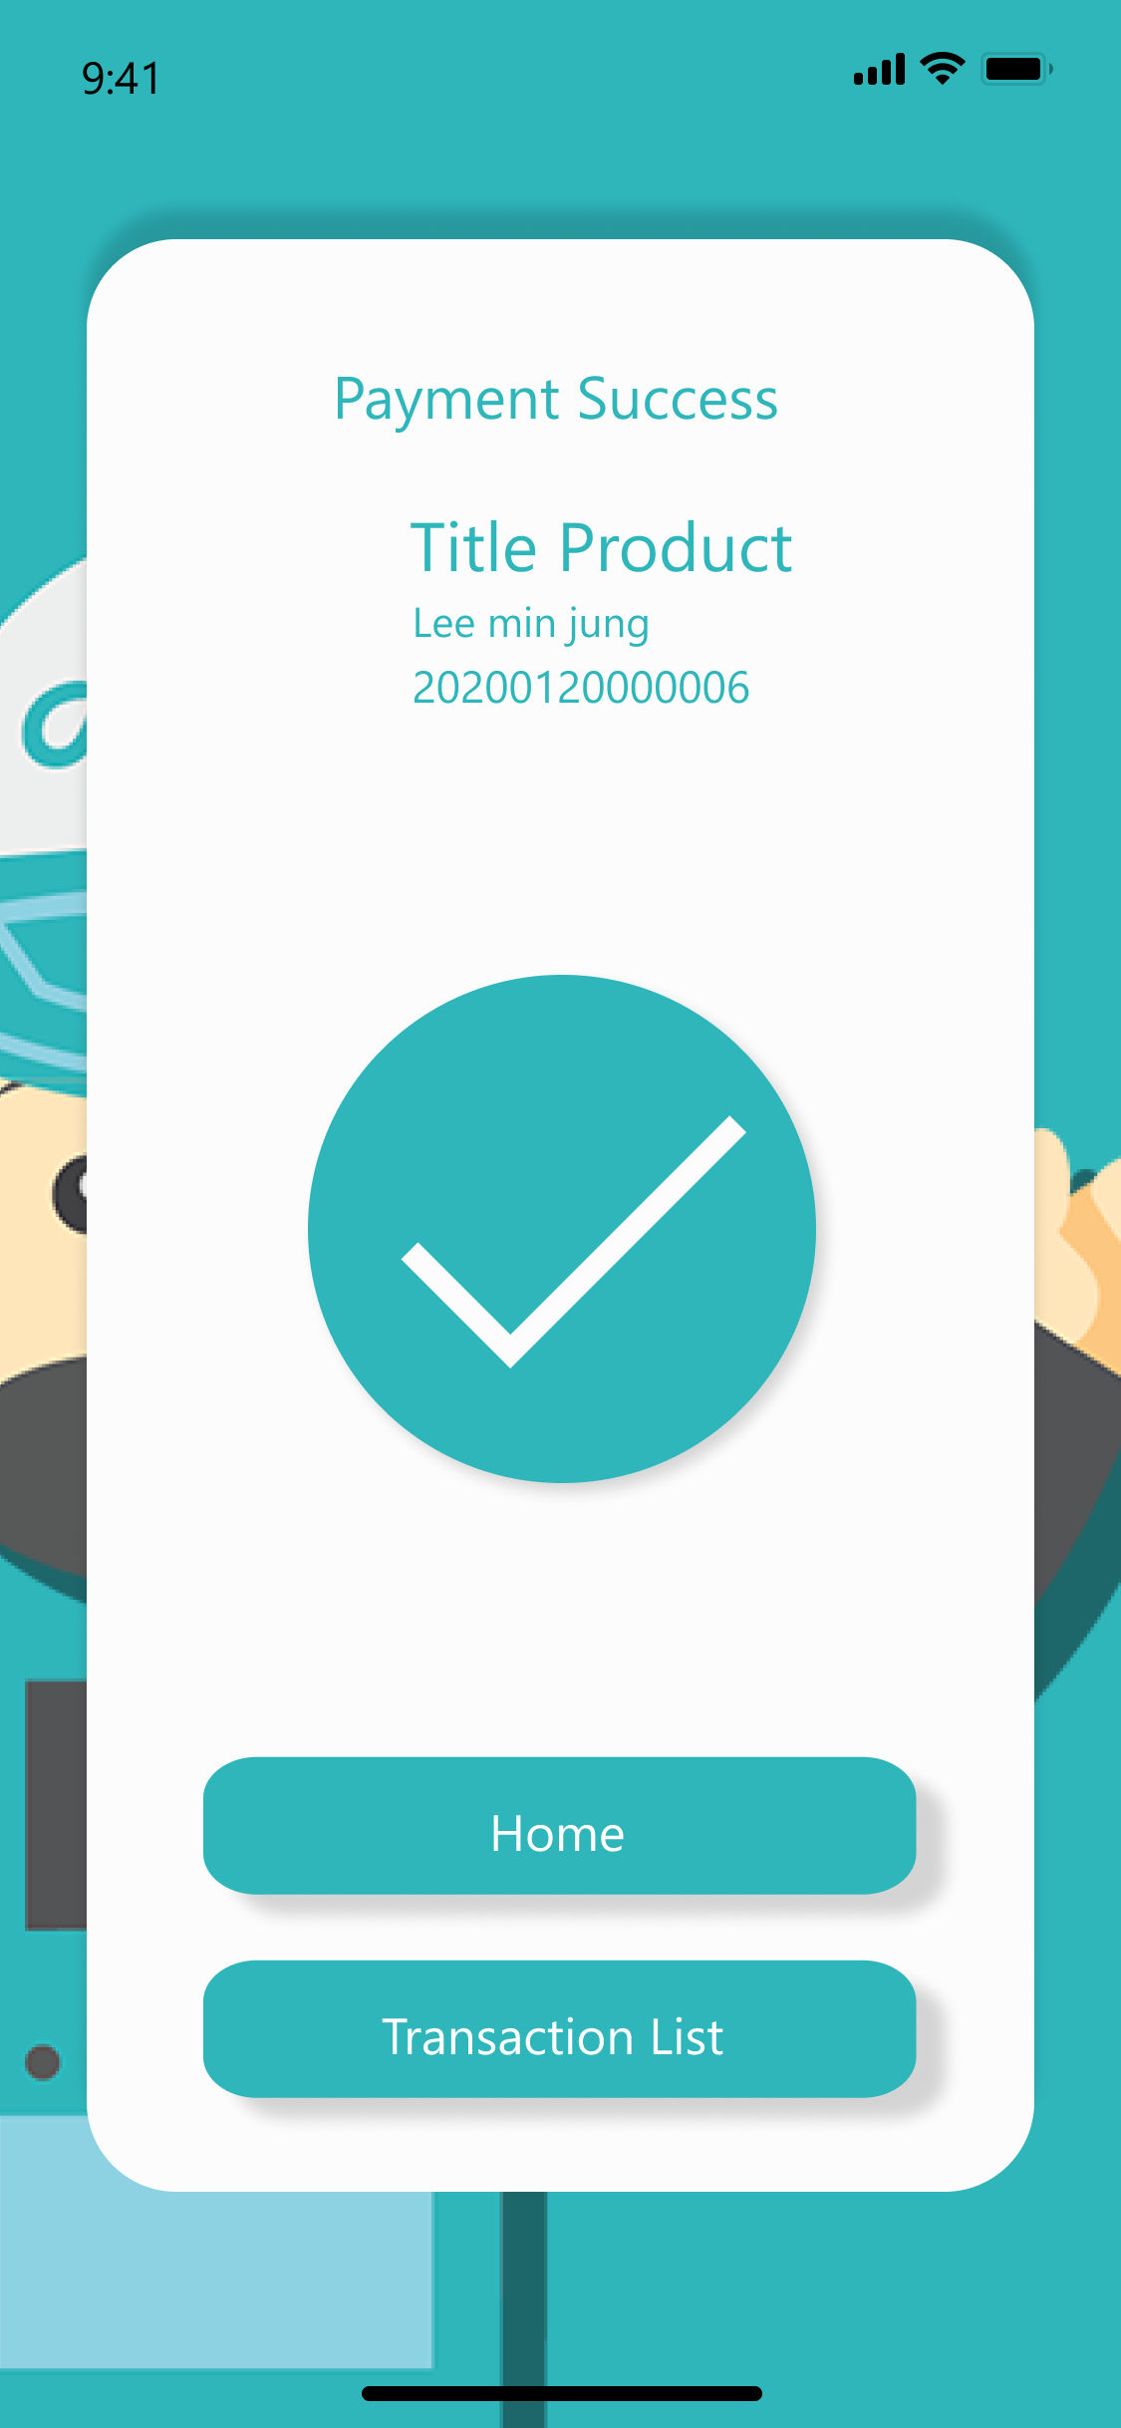
PAYMENT PAGE

Slide 23
15th WEEK
If there has any revision from the whole design page, we will revise it
Creating social media account (Instagram, etc.) and pamphlet for promoting
Promoting

Slide 24
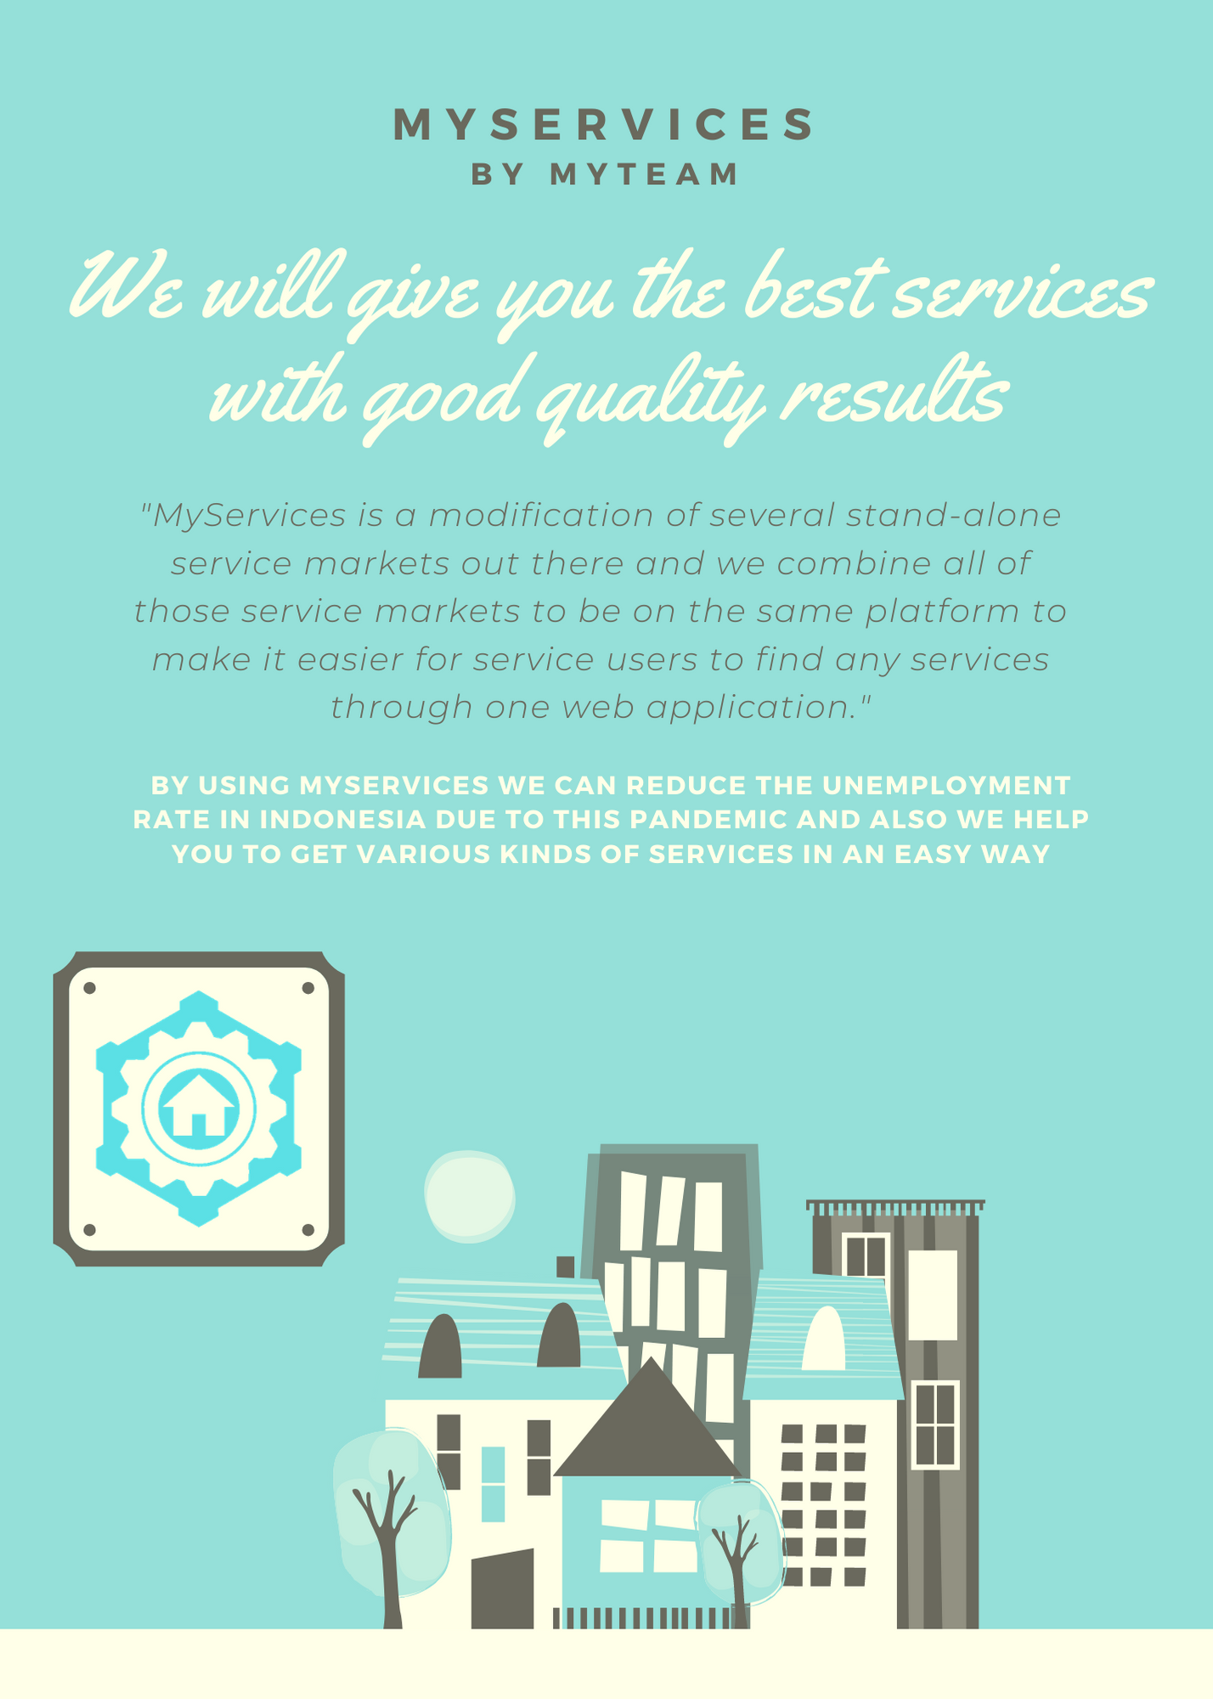

PAMPHLET

Slide 25
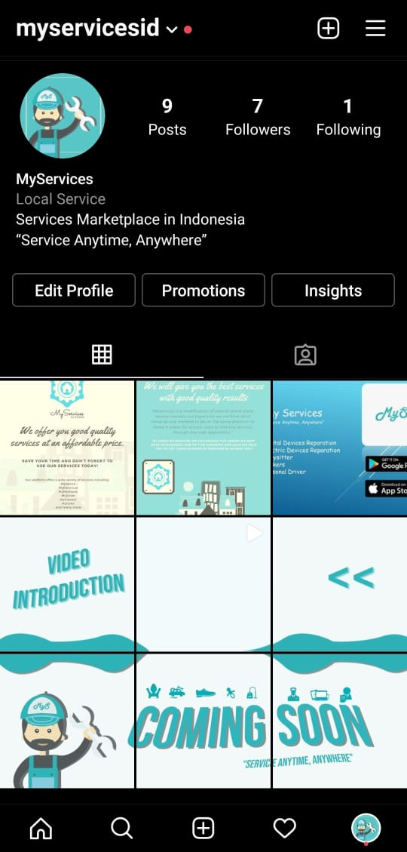
SOCIAL MEDIA ACCOUNT

Slide 26
THANK YOU!!
Do you have any questions or feedback?

